Slide 1
Specialized Faculty Promotion Workshop
April 8, 2024
Janet Kistner
VP Faculty Development & Advancement
Notes:
Goals of today’s meeting: 1) brief presentation (slides will be made available) not going to get into the weeds, we do that in other venues (P&T workshops, closer to time of tenure review) or get into the history and merits of university tenure (interesting but not enough time) – instead will give an overview of criteria & procedures for getting tenure at FSU; want to leave plenty of time for discussion at your tables, opportunity to ask questions, share experiences – facilitator at each table (what is said in the room, stays in the room).
Other goals of this meeting – feedback for me on new faculty orientation. What it did and did not prepare you for? Suggestions on improving NFO. Finally – opportunity to reconnect with your NFO cohort.

Slide 2
SPECIALIZED FACULTY CLASSIFICATIONS
TEACHING FACULTY
RESEARCH FACULTY/CURATOR
RESEARCH SUPPORT
INSTRUCTIONAL SUPPORT
UNIVERSITY LIBRARIAN
Notes:
Types of evidence included in promotion materials varies by classification – e.g., outside letters required of some SF such research faculty and Medicine’s clinical faculty but not of most SF; SPCIs included for TF and for others whose assignments include teaching but not for other SFs. Melissa will provide some of this information in her presentation but – importantly – you will find detailed information in our Promotion memo – for each SF classification (and this information is reviewed carefully with staff in a separate workshop.

Slide 3
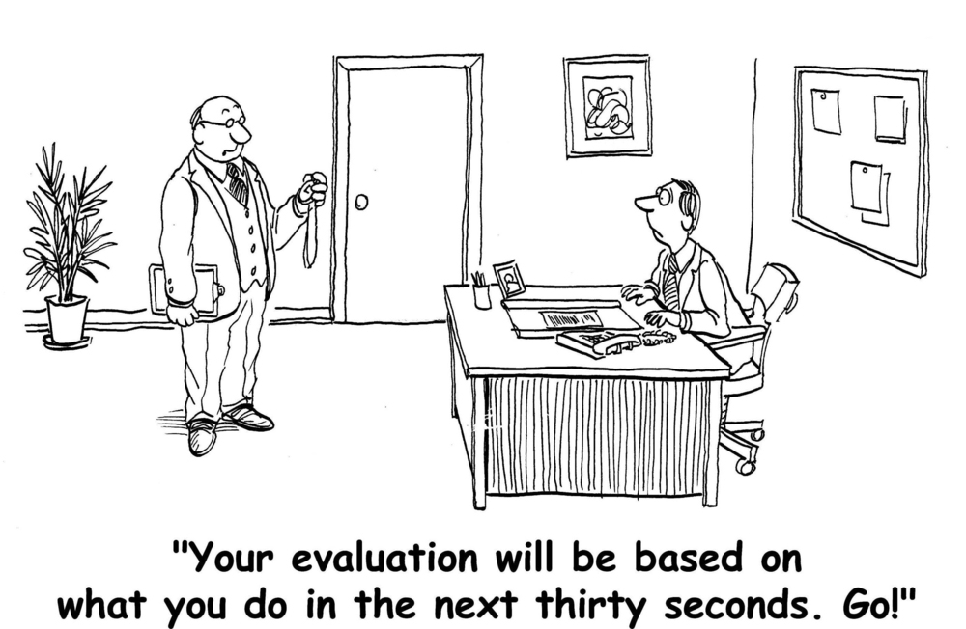
How do I know if I’m making progress toward promotion?
Notes:
Provide guidance/encouragement to actively plan and frequently participate in professional development/scholarly activities.

Slide 4
Specialized Faculty Evaluations
When do evaluations occur?
Annually: ratings plus progress toward Promotion letters
Who evaluates you for promotion?
Faculty in your academic unit (often a designated committee)
Department Chair/School Director or Supervisor
College/Unit Committee & Dean/Director
Provost/VP of Research & President
Notes:
Reviewed at the department/center/institute level, then at the dean’s level, then comes to FDA and sent on to the Provost & President for final review. Composition of review committee at the “unit” level is provided in your unit’s bylaws.

Slide 5
Eligibility for Promotion
Evidence of sustained excellence in performance in assignment of responsibilities
Supervisor/committee recommends candidates for promotion
Should be clear from your annual “Progress Toward Promotion” letters
Typically, a promotion candidate in 5th year
Notes:
Jim Smith: No “or” in the criteria
What constitutes sufficient evidence? Not a simple answer, no formula, no minimum number of x or y. It’s about excellence, impact.
BUT – there should be no surprises – you should know well in advance if you are on track (or not) for promotion. Goes back to what I said a few minutes ago about the university’s obligation to provide you with constructive timely feedback on your progress toward promotion.

Slide 6
What Evidence will represent you?
Letters from your chair/supervisor/director/dean
CV
Evidence of Achievements
Annual Letters of Progress toward Promotion
Statements (varies by position)
Letters from colleagues at FSU (for some positions)
Letters from external reviewers (for some positions)
** NEED TO CHECK YOUR UNIT’S PROMOTION CRITERIA AND PROCEDURES **

Slide 7
Early Promotion?
Promotion candidate prior to 5th year in rank
Requires evidence of exceptionally meritorious performance
May have years credited toward promotion when hired
Visiting status may count if the assignment of responsibilities remains the same
Highly unlikely to be promoted with less than 3 years in rank (difficult to judge “sustained” excellence in the position)
Notes:
Not a technical term: “early” promotion but get asked about this a lot so am addressing here.

Slide 8
Typical Promotion Timeline* *for Level 1 specialized faculty with no “promotion credit”
Spring semester of your 4th year: department/unit recommends that you put together materials for Promotion review (or recommends postponing until later)
Summer between your 4th & 5th years: Prepare your promotion “binder” (a single pdf file).
Fall semester of your 5th year: after review and votes from your unit and your dean/director, your “e-binder” is submitted to FDA.

Slide 9
Faculty Candidate’s Role
Make it easy for your faculty colleagues, chair, dean to see what you’ve accomplished
Tell “your story” well
What are your most important professional accomplishments?
Why is your work important to the university? (and for research faculty also to the nation and the world?)
Notes:
Always keep your “audience” in mind – who is reviewing and voting on your promotion.

Slide 10
Revised guidelines for writing teaching statements posted on FDA website
Showcase your teaching expertise
Guidelines are questions to help you reflect on your teaching and how you have developed as a teacher
Some examples:
What are your goals for student learning in your courses?
What strategies or approaches do you use to help students achieve these goals
How do you gather evidence of student learning?
How have you used feedback to improve your teaching or course design?
Notes:
These are on the FDA website. Good idea to have a couple of knowledgeable and trusted colleagues review your statements before adding to your binder.

Slide 11
Modifications and Considerations due to covid-19
Considering the online transmission of classes and other disruptions to teaching due to COVID-19, ratings from student course evaluations (SPCI) in Spring 2020, Summer 2020 and Fall 2020 will be excluded from promotion materials, unless promotion candidates request their inclusion
Do include professional activities (e.g., conference presentation; invited address) that were cancelled due to COVID on your Promotion CV with this note: “Cancelled due to COVID”
Do discuss any negative impact of current COVID-related circumstances (e.g., Human Subjects research not permitted; delays in reviews of book contracts, journal submissions) with your supervisors (chairs, directors, deans) and mentor committees; this information should be noted in future Progress toward Promotion letters and duly considered when conducting future faculty evaluations
Notes:
May need to update tenure clock adjustments – currently under discussion

Slide 12
Questions?
Janet Kistner
Vice President for Faculty Development and Advancement
jkistner@fsu.edu
850-644-6876

Slide 13
Melissa Crawford faculty administrator

Slide 14
How do I get started?
First rule of the promotion process
Make sure you know who the person is in your department, college or center/institute who can help you!
This person can help you organize your materials into the proper format and will submit them by the deadline (October 25, 2024).
If you don’t know who this person is, ask your chair/supervisor or dean/director.

Slide 15
Preparing your eBinder
The second rule of the promotion process
Read the informational memo and other information on the FDA website: https://fda.fsu.edu/faculty-development/promotions-for-specialized-faculty
Guidelines for Writing Personal Statements
FEAS+ and ORCID Guides
Checklists for each track (details in memo)
Teaching Faculty (page 5)
Research Faculty/Curator (page 9)
Instructional Specialist (page 12)
Research Support (page 15)
Librarians (page 17)

Slide 16
College of Medicine
Clinical Assistant Professors and Clinical Associate Professors
https://fda.fsu.edu/faculty-development/medicine-promotions
Follows the tenure-track procedures.
Binders are due with the Specialized Faculty binders
(October 25, 2024)
Contact your department or college delegate for more information.

Slide 17
FEAS+/ORCID Questions
Tiffany Phillips
tphillips@fsu.edu
https://feas.fsu.edu
https://orcid.fsu.edu

Slide 18
Questions?
Department/School/College/Center Staff
Specialized Faculty Promotion Memo found here: https://fda.fsu.edu/faculty-development/promotions-for-specialized-faculty
Janet Kistner, jkistner@fsu.edu
Melissa Crawford, mucrawford@fsu.edu
Email me your FSUID to be added to the Canvas site for sample binders.

